Slide 1

Discussion: Inside the Boardroom by R. L. Bennett, M. Puri & P. E. Soto
Advanced analytics: new methods and applications for
macroeconomic policy
04/11/2021
Disclaimer: the views expressed here are those of the authors not those of the ECB or the Eurosystem

Slide 2

Overview
An impressive database of banks’ documents:
174 banks
500,000 documents + bank characteristics
ML methods to identify the relevant information in the dataset:
year>2001
Select only board of director meeting minutes
Final data: 34 banks, 4000 meeting minutes

Slide 3
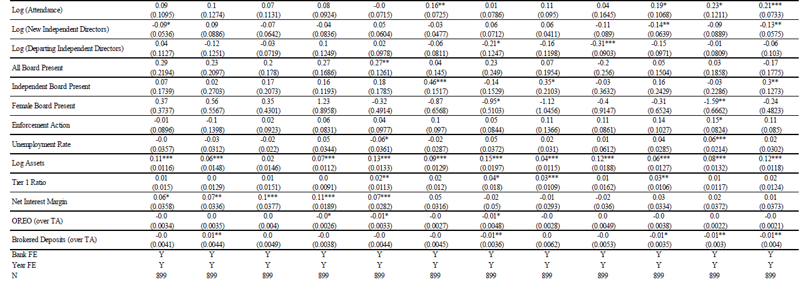
Q1: what explains topics?

Slide 4
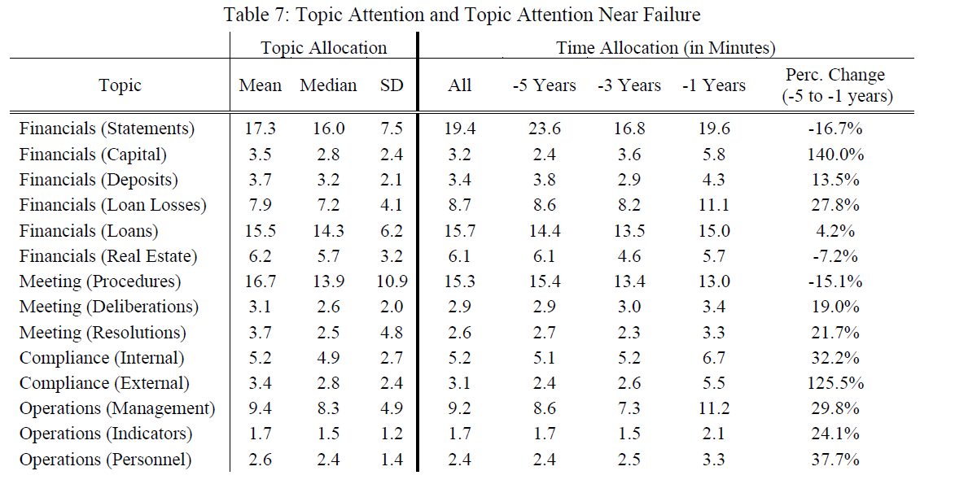
Q2: what bankers discuss during a crisis?

Slide 5
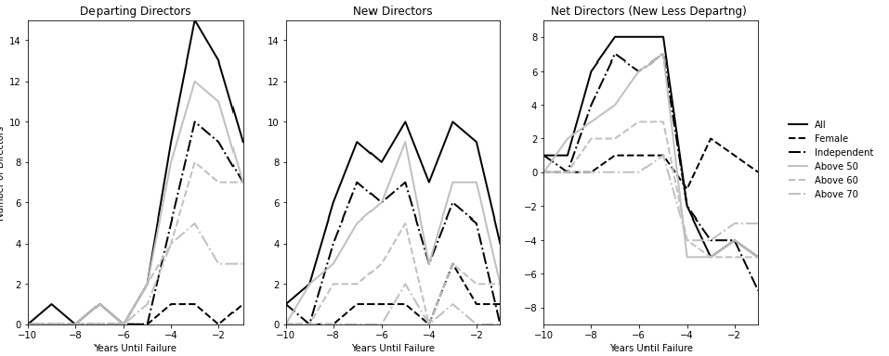
Q3: what happens to the board near failures?

Slide 6
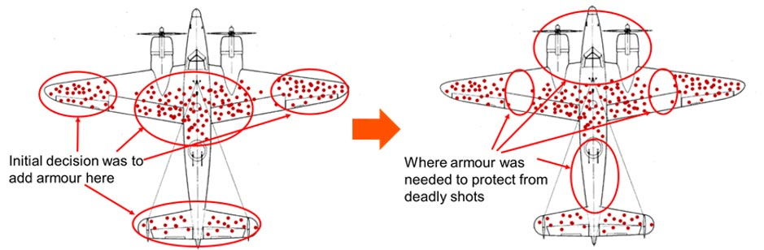
Comment 1: observation bias?

Slide 7


Comment 2: can a counterfactual be constructed?
Not all banks fail at the same time!
Suggestion: diff-in-diff vs non failed banks or a synthetic non failed bank
Same bank, same year, not failed
are those differences significant?

